Slide 1
Model and Verify CPS using Probabilistic Automata
By Asm Nurussafa

Slide 2
Agenda
Introduction
Probabilistic models
Markov Decision Process
Probabilistic Reachability
Computing Reachability
Summary

Slide 3
1. 1. Verification
Formal verification - is the application of rigorous, mathematics-based techniques to establish the correctness of computerised systems.
Quantitative verification - applies formal verification techniques to the modelling and analysing of non-functional aspects of system behaviour (e.g. probability, time, cost,..)
Probabilistic model checking - is an automated quantitative verification technique for systems that exhibit probabilistic behavior

Slide 4
1. 2. Probabilistic Model Checking
Why probability ? - unrealiability (e.g. component failures) - uncertainty (e.g. message losses/delays over wireless) -randomisation (e.g. in protocols such as Bluetooth, ZigBee) -stochasticity (e.g. bilogical/chemical reaction rates)
Quantitative properties - reliability, performance, quality of service..

Slide 5
1. 2. Probabilistic Model Checking (cont.)
Construction and analysis of finite probabilistic models - e.g. Markov chains, Markov decision processes, .. - specified in high-level modelling formalisms -exhaustive model exploration (all possible states/executions)
Automated analysis of wide range of quantitative properties - properties specified using temporal logic - exact results obtained via numerical computation -linear equation systems, iterative methods, uniformisation -efficient techniques for verification + performance analysis

Slide 6
2. Probabilistic Models

Slide 7
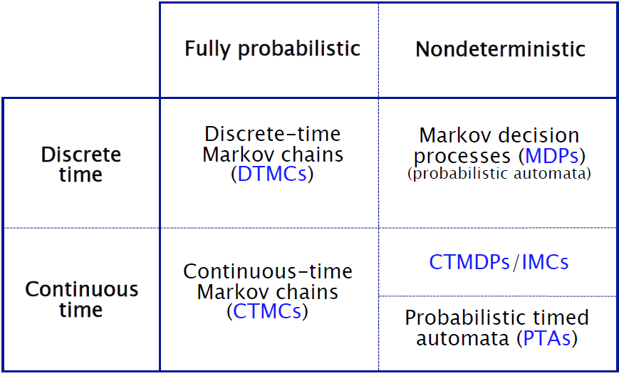
2. Probabilistic Models

Slide 8
3. Markov Decision Process

Slide 9
3. 1. Non-determinism
Some aspects of a system may not be probabilistic and therefore, should not be modelled probabilistically
Concurrency – scheduling of parallel components -e.g. randomised distributed algorithms- multiple probabilistic processes operation asynchronously.
Unknown environments -e.g. probabilistic security protocols – unknown adversary
Underspecification – unknown model parameters -e.g. a probabilistic communication protocol designed for message propagation delays between dmin and dmax.
Abstraction

Slide 10
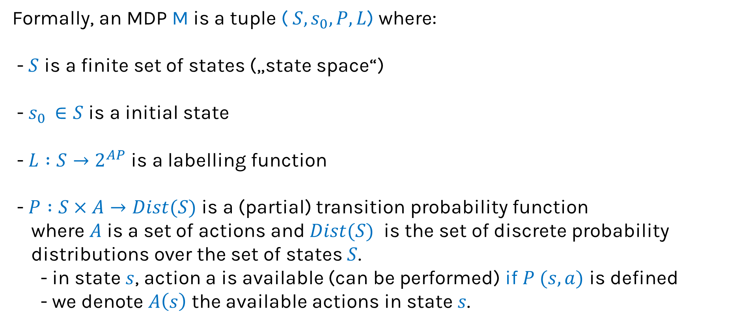
3. 2. Markov Decision Process
Formally, an MDP M is a tuple ( ${S, s}_{0}, P,L$) where: - $S$ is a finite set of states („state space“)
- $s_{0 }∈S$ is a initial state
- $L :S→2^{AP}$ is a labelling function
- $P :S×A→Dist(S)$ is a (partial) transition probability function where $A$ is a set of actions and $Dist(S)$ is the set of discrete probability
distributions over the set of states $S$. - in state $s$, action a is available (can be performed) if $P (s,a)$ is defined
- we denote $A\left(s\right)$ the available actions in state $s$.

Slide 11
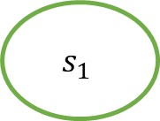
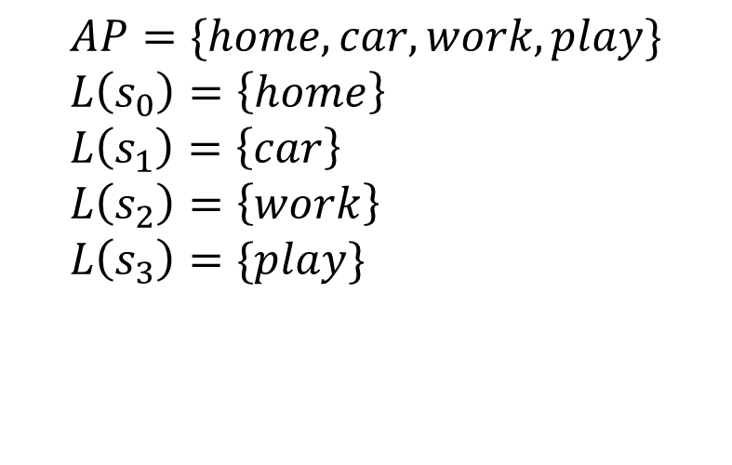

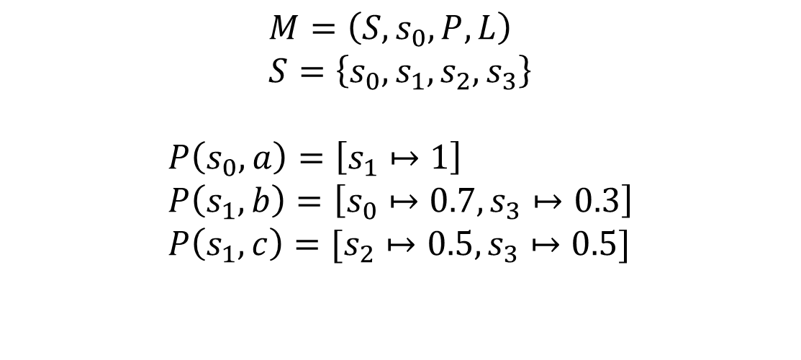
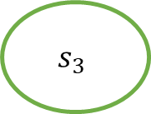

3. 3. Markov Decision Process example
a
0.5
1
$$s_{2}$$
{work}
c
{home}
{car}
$$s_{0}$$
$$s_{1}$$
0.5
0.7
$$s_{3}$$
{play}
b
0.3
$$M=\left(S,s_{0}, P,L\right) \\ S=\left\{s_{0}, s_{1},s_{2},s_{3}\right\}$$
$$P\left(s_{0},a\right)=\left[s_{1}↦1\right] \\ P\left(s_{1},b\right)=\left[s_{0}↦0.7,s_{3}↦0.3\right] \\ P\left(s_{1},c\right)=[s_{2}↦0.5,s_{3}↦0.5]$$
$$AP=\{home,car,work,play\} \\ L\left(s_{0}\right)=\left\{home\right\} \\ L\left(s_{1}\right)=\left\{car\right\} \\ L\left(s_{2}\right)=\left\{work\right\} \\ L\left(s_{3}\right)=\{play\}$$

Slide 12
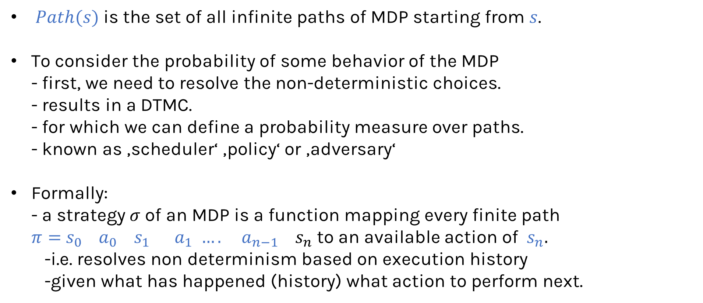
3. 4. Paths and Strategies
$Path(s)$ is the set of all infinite paths of MDP starting from $s$.
To consider the probability of some behavior of the MDP - first, we need to resolve the non-deterministic choices. - results in a DTMC. - for which we can define a probability measure over paths. - known as ‚scheduler‘ ‚policy‘ or ‚adversary‘
Formally: - a strategy $σ$ of an MDP is a function mapping every finite path $π=$ $s_{0} { a}_{0}$ ${ s}_{1}{ a}_{1} ….{ a}_{n−1}{ s}_{n}$ to an available action of ${ s}_{n}.$ -i.e. resolves non determinism based on execution history -given what has happened (history) what action to perform next.

Slide 13

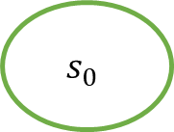
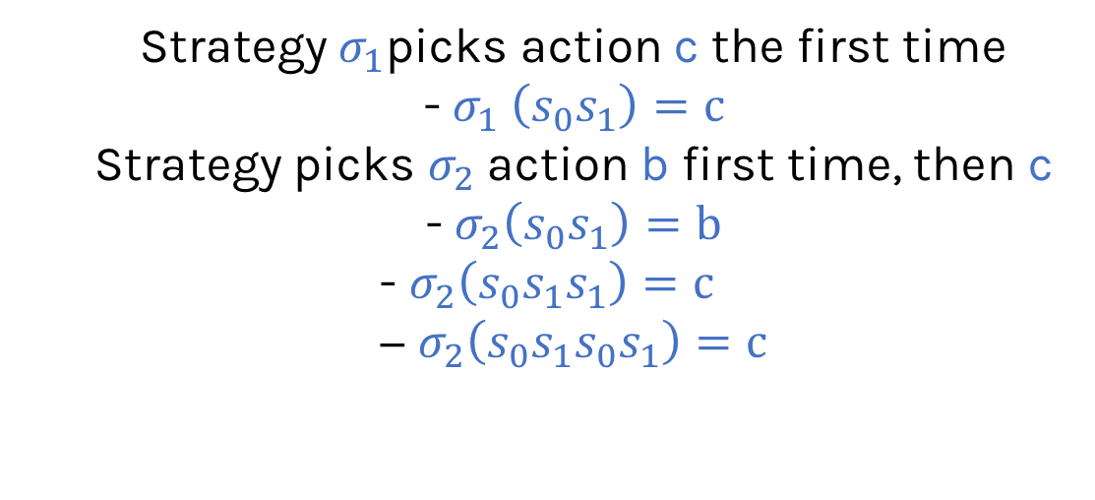
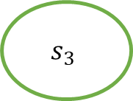

3. 4. Paths and Strategies (cont‘d)
a
0.5
1
$$s_{2}$$
{work}
c
Strategy $σ_{1}$picks action c the first time - $σ_{1} \left(s_{0}s_{1}\right)=c$ Strategy picks $σ_{2}$action b first time, then c - $σ_{2}\left(s_{0}s_{1}\right)=b$ $$\text{− }σ_{2}\left(s_{0}s_{1}s_{1}\right)=c \\ \text{− }σ_{2}\left(s_{0}s_{1}s_{0}s_{1}\right)=c$$
{home}
{car}
$$s_{0}$$
$$s_{1}$$
0.5
0.7
$$s_{3}$$
{play}
b
0.3

Slide 14
4. Probabilistic Reachability

Slide 15
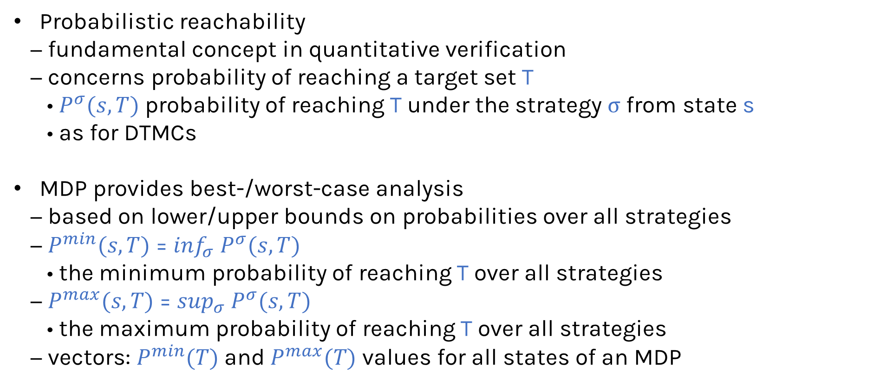
4. Probabilistic reachability
Probabilistic reachability
− fundamental concept in quantitative verification
− concerns probability of reaching a target set T
• $P^{σ}(s,T)$probability of reaching T under the strategy σ from state s
• as for DTMCs
MDP provides best-/worst-case analysis
− based on lower/upper bounds on probabilities over all strategies
− $P^{min}(s,T)$ = $\inf_{σ} P^{σ}(s,T)$
• the minimum probability of reaching T over all strategies
− $P^{max}(s,T)$ = $\sup_{σ} P^{σ}(s,T)$
• the maximum probability of reaching T over all strategies
− vectors: $P^{min}(T)$and $P^{max}(T)$ values for all states of an MDP

Slide 16


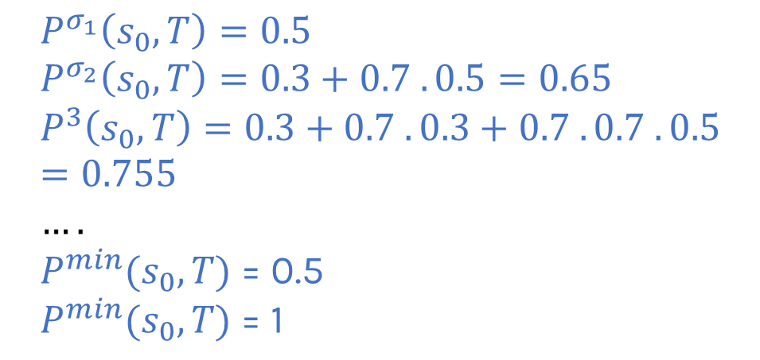


4. 2. Example – target T equals {play}
Example- Strategy $σ_{1}$that first selects b the first i-1 times in state $s_{1}$ and then c.
a
0.5
1
$$s_{2}$$
{work}
c
$$P^{σ_{1}}\left(s_{0},T\right)=0.5 \\ P^{σ_{2}}\left(s_{0},T\right)=0.3+0.7 . 0.5=0.65 \\ P^{3}\left(s_{0},T\right)=0.3+0.7 . 0.3+0.7 . 0.7 . 0.5=0.755 \\ …. \\ P^{min}(s_{0},T) \text{=}\text{ 0.5} \\ P^{min}(s_{0},T) \text{= }\text{1}$$
{home}
{car}
$$s_{0}$$
$$s_{1}$$
0.5
0.7
$$s_{3}$$
{play}
b
0.3

Slide 17
5. Computing Reachability

Slide 18
5. 1. Computing reachability probabilities
Value iteration
− approximate with iterative solution method.
− corresponds to fixed point computation.
Reduction to a linear programming (LP) problem
− solve with linear optimisation techniques
− exact solution using well-known methods
Policy iteration - iteration over strategies.

Slide 19
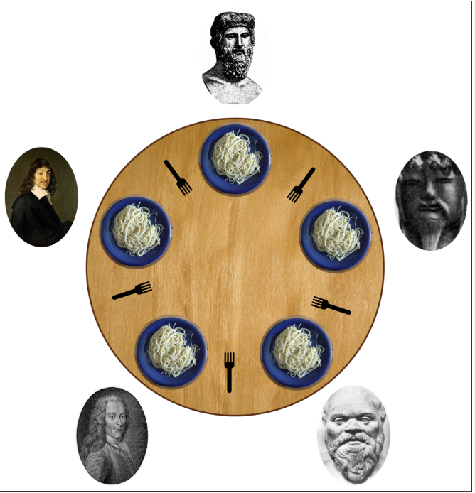
5. 2. The dining philosophers problem
Problem:
- Certain no of philosophers spend their time thinking or eating.
- A philosopher needs both forks in order to eat. - A philosopher may only pick up one fork at a time and when he is done eating, both forks are placed back and returns to thinking.
Image source: https://www.prismmodelchecker.org/tutorial/images/dining-phil.png

Slide 20
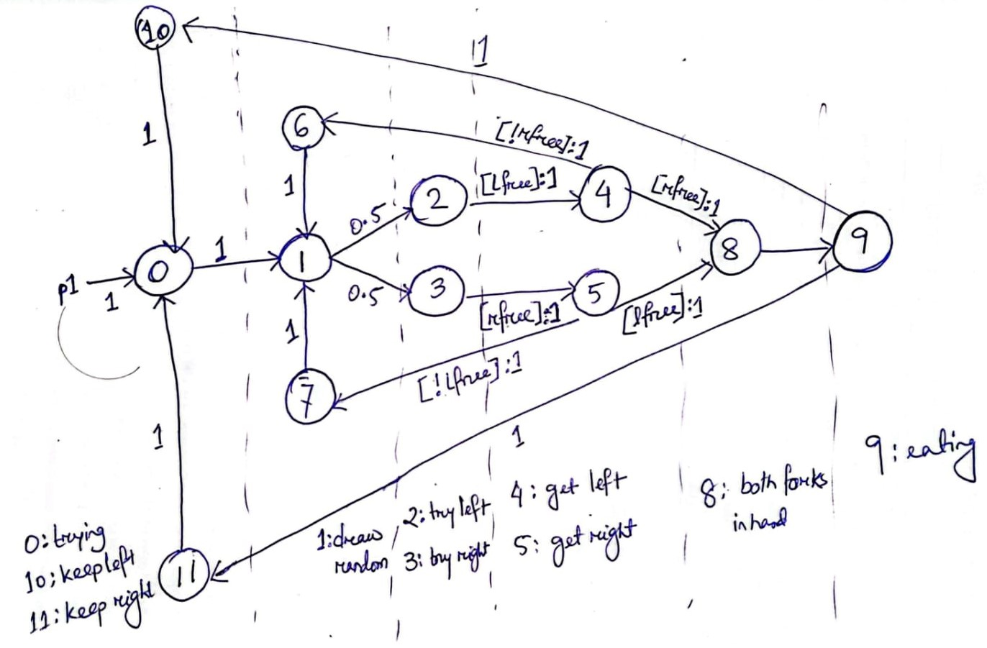
5. 3. The dining philosophers problem- model
[8: LR81]

Slide 21
6. Summary

Slide 22
Thank you!
Any questions ?

Slide 23
Literature
[1] Bianco, Andrea; Alfaro, Luca de: Model checking of probabilistic and nondeterministic
systems. In: International Conference on Foundations of Software Technology and
Theoretical Computer Science. Springer, pp. 499–513, 1995.
[2] Baier, Christel; de Alfaro, Luca; Forejt, Vojtěch; Kwiatkowska, Marta: Model checking
probabilistic systems. In: Handbook of Model Checking, pp. 963–999. Springer, 2018.
[3] Baier, Christel; Größer, Marcus; Ciesinski, Frank: Quantitative analysis under fairness
constraints. In: International Symposium on Automated Technology for Verification and
Analysis. Springer, pp. 135–150, 2009.
[4] Billingsley, P: Probability and Measure. 3rd Wiley. New York, 1995.
[5] Baier, Christel; Katoen, Joost-Pieter: Principles of model checking. MIT press, 2008. [6] Clarke, Edmund M; Emerson, E Allen: Design and synthesis of synchronization skeletons
using branching time temporal logic. In: Workshop on logic of programs. Springer, pp.
52–71, 1981.
[7] De Alfaro, Luca: From fairness to chance. Electronic Notes in Theoretical Computer
Science, 22:55–87, 1999. [8] Lehmann, D., & Rabin, M. O. (1981, January). On the advantages of free choice: A symmetric and fully distributed solution to the dining philosophers problem. In Proceedings of the 8th ACM SIGPLAN-SIGACT symposium on Principles of programming languages (pp. 133-138).

